Slide 1

WELCOME
Technical
Analysis
Concepts
Introduction
to
Stock Markets

Slide 2
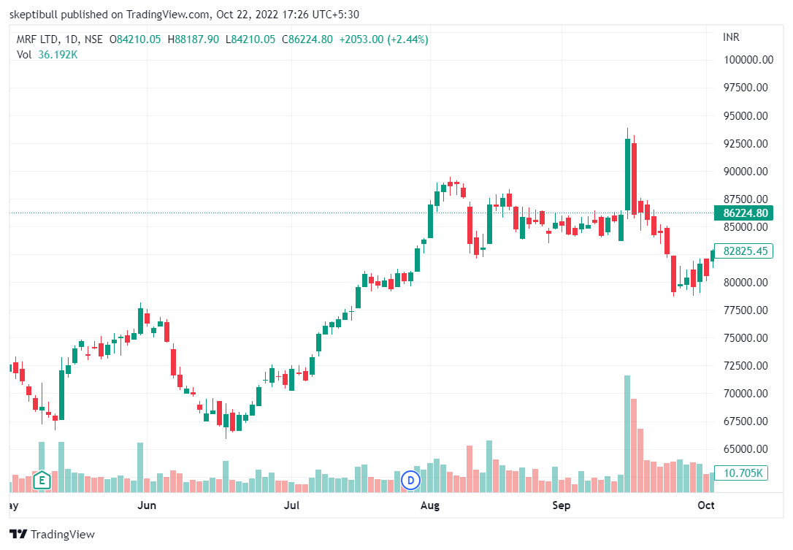
Technical
Analysis
Chart
Analysis
=
Price
Volume

Slide 3
Technical Analysis:
Trend and Trendline
Support & Resistance
Moving Average
Breakout
Volume
Purpose:
Entry
Exit

Slide 4
1. Market Capitalization
Or MarCap
Current valuation of company
No of shares * CMP
MarCap in Crore | Classification
< 5000 | Small Cap
5000 – 20000 | Medium Cap
> 20000 | Large Cap

Slide 5
2. Price/Earning (PE)
Valuation = Cheap or Expensive
PE = Current Price
Earing Per Share
Stock PE v. Industry PE

Slide 6



Shrewd Investor
Fundamental Analysis
Ratio Analysis
Stock Selection
Investment Strategies
Risk Management
Swing Trading
Sunday 10 AM
Duration 6-8 hours
Zoom or Skype

Slide 7
#06283D
#F4F4F2
#FEB202
#FF8701

